Slide 1

Machine Learning course 2023. Final Project 11.
Contrastive Learning for Event Sequences with Self-Supervision on multiple domains
Replication study
Denis Grankin
Ekaterina Andreichuk
Ivan Apanasevich
Irena Gureeva
Mikhail Konenkov

Slide 2
Motivation
Learning best algorithms for lifestream data embeddings
Extracting embeddings from event sequences is a useful approach that can be used for learning users preferences, advising customers products based on their clickstream data and many other real-world applications. However, classical methods for analyzing event sequences that are attributed to a person and capture their regular and routine behavior do not capture relationships between single object and its immediate neighborhood very well. Also, it usually requires a labeled data to operate this.
Therefore, new methods for data augmentation and event sequences extraction is needed.

Slide 3
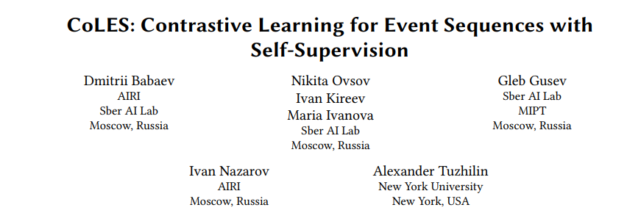
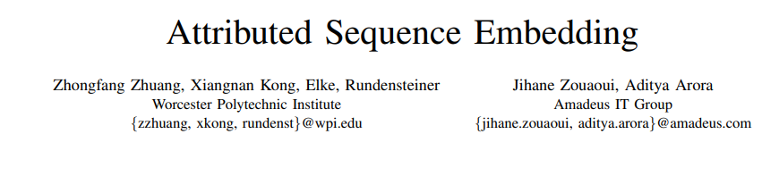
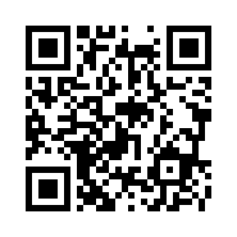
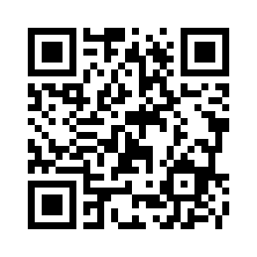
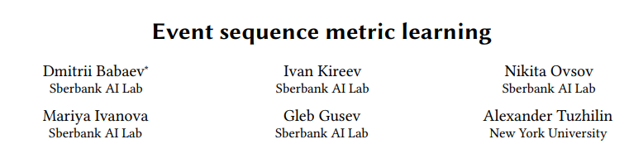
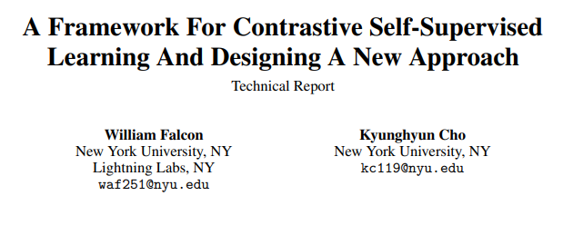
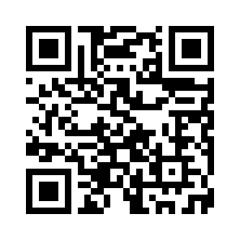

Related work
The paper on which our replication study is based on.
Study about extracting data embeddings from attributed sequences.
Metric learning method for producing embeddings of complex event sequences. The main advantage is that almost no pre-processing is needed for complex even streams to get their compact embedding.
Study with analysis of contrastive learning approaches and conceptual framework for Contrastive Learning.

Slide 4
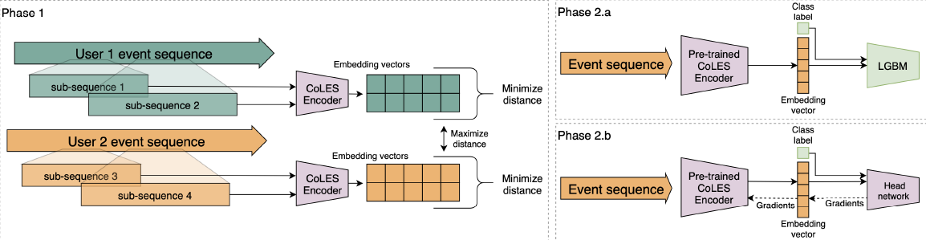
CoLES framework
Figure 1: General framework. Phase 1: Self-supervised training. Phase 2.a Self-supervised embeddings as features for supervised model. Phase 2.b: Pre-trained encoder fine-tuning.

Slide 5
DataFusion 2022 datasets
We have datasets with industrial data of transactions and clickstreams.
Due to this data we need to predict whether a client has a higher education.
transactions.zip (263Mb)
bank customer ID
mcc-code of transaction
transaction currency
amount in transaction currency
date and time of the transaction
clickstream.zip (470Mb)
ISP client ID
visited categories
date and time of page visit
device ID
train_matching.zip (1Mb)
bank customer ID (from transactions)
customer ID (from clickstream)

Slide 6
Hyperparameters

Slide 7
Conducted Experiments

Slide 8
Analyzed methods

Slide 9
General pipeline

Slide 10
Transactions

Slide 11
Clickstreams. PySpark

Slide 12
Results

Slide 13
Results

Slide 14
Contribution

Slide 15
Conclusion
pytorch-lifestream library was implemented for event sequences data extraction and CoLES method was used for embeddings
Data Fusion 2022 datasets were investigated and prepared for testing
Downstream tasks were implemented for data embeddings extracted with CoLES method and …

